Slide 1
Colocation Pattern Discovery
Zhe Jiang
zjiang@cs.ua.edu

Slide 2
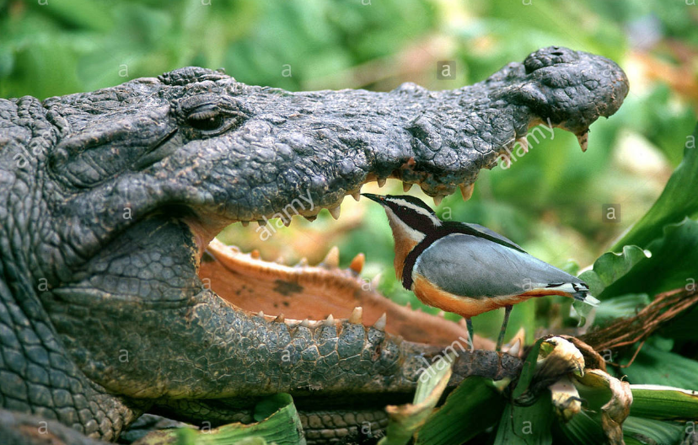
Colocation Pattern and Examples
Colocation: a set of spatial features that frequently occur in together
Example:
Ecology: symbiotic relationship in animals or plants
Public health: environmental factors and cancers
Public safety: crime generators and crime events
Nile Crocodiles and Egyptian Plover
Bar closing events and crimes
http://www.alamy.com/
http://www.startribune.com/

Slide 3
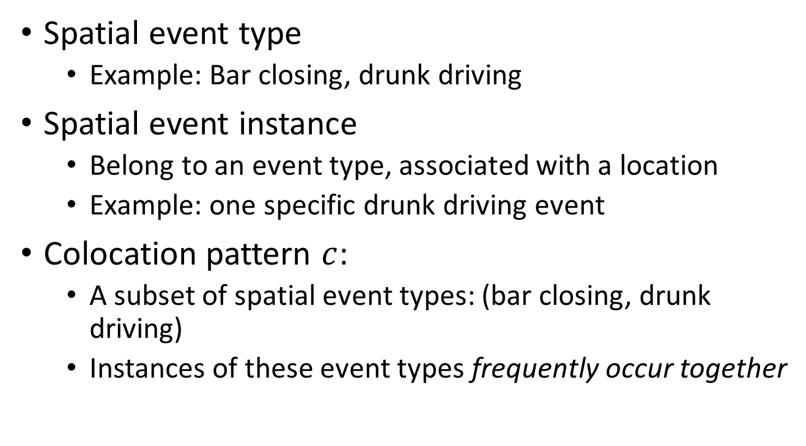
Basic Concepts
Spatial event type
Example: Bar closing, drunk driving
Spatial event instance
Belong to an event type, associated with a location
Example: one specific drunk driving event
Colocation pattern $c$:
A subset of spatial event types: (bar closing, drunk driving)
Instances of these event types frequently occur together

Slide 4
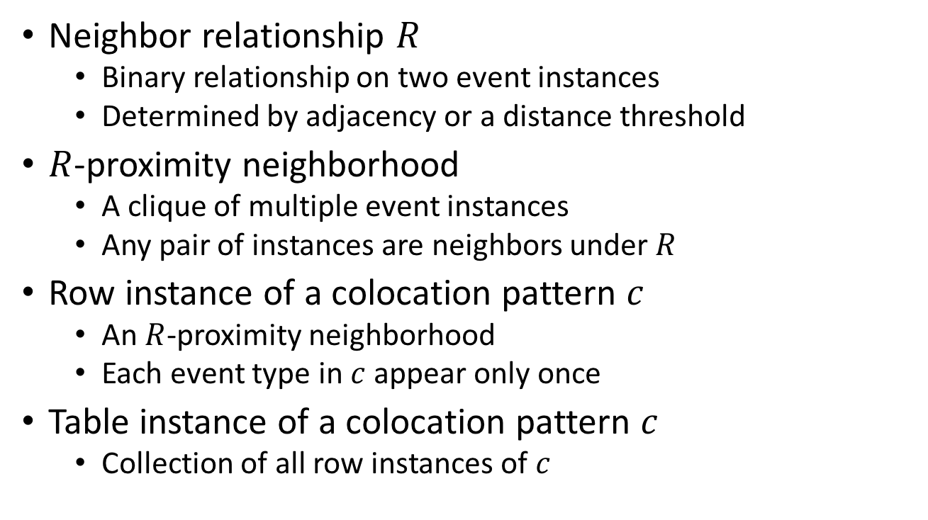
Basic Concepts
Neighbor relationship $R$
Binary relationship on two event instances
Determined by adjacency or a distance threshold
$R$-proximity neighborhood
A clique of multiple event instances
Any pair of instances are neighbors under $R$
Row instance of a colocation pattern $c$
An $R$-proximity neighborhood
Each event type in $c$ appear only once
Table instance of a colocation pattern $c$
Collection of all row instances of $c$

Slide 5
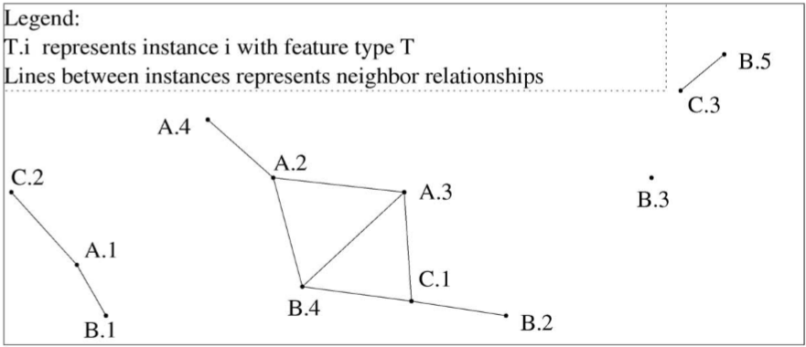
Basic Concept Example
Spatial event types
A, B, C
Candidate Colocation
(A, B), (B, C) …
Table instance of (A, B)
(A.1, B.1)
(A.2, B.4)
(A.3, B.4)
Spatial event instances
A.1, A.2, A.3, … ...
Neighbor relationship (solid line)
(A.1, B.1), (A.1, C.2) …
Q: Table instance of (A, B, C)?

Slide 6
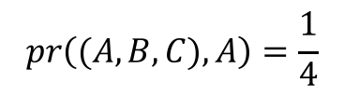
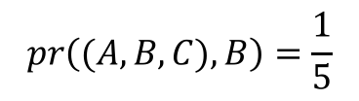
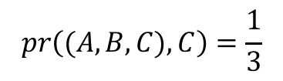
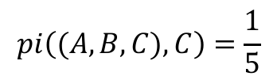

Interestingness Measure
Participation ratio $pr$
Given colocation pattern $c=\left(f_{1},f_{2},…,f_{k}\right)$
$pr\left(c,f_{i}\right)=\frac{{|π}_{f_{i}}Table.Instance(c)|}{|Table.Instance(f_{i})|}$
Participation index $pi$
$pi\left(c\right)=\min_{i}\{pr\left(c,f_{i}\right)\}$
Example:
T1 | T2 | T3
A | B | C
A.1 | B.1 | C.1
A.2 | B.2 | C.2
A.3 | B.3 | C.3
A.4 | B.4
 | B.5
T7
ABC
A.3 B.4 C.1
$$pr\left((A,B,C),A\right)=\frac{1}{4}$$
$$pr\left((A,B,C),B\right)=\frac{1}{5}$$
$$pr\left((A,B,C),C\right)=\frac{1}{3}$$
$$pi\left((A,B,C),C\right)=\frac{1}{5}$$

Slide 7
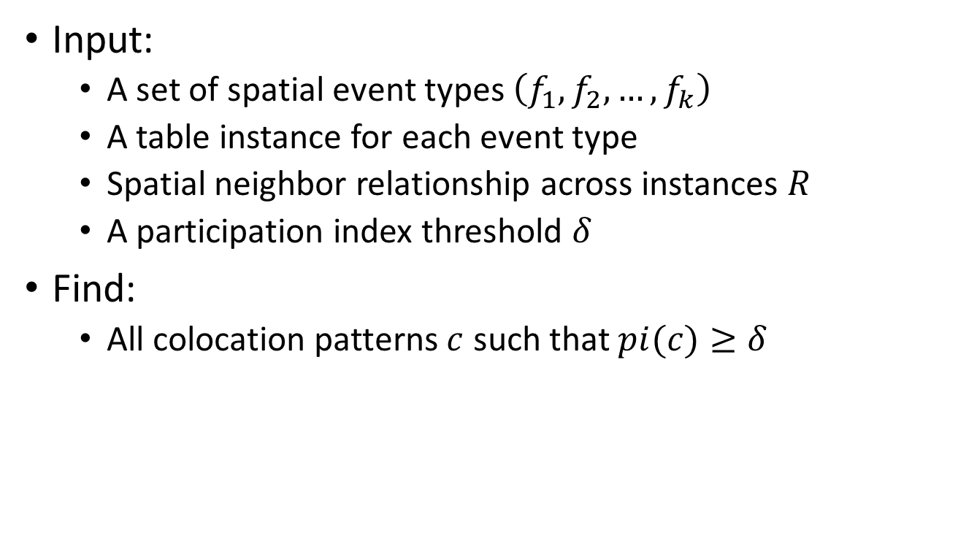
Problem Definition
Input:
A set of spatial event types $\left(f_{1},f_{2},…,f_{k}\right)$
A table instance for each event type
Spatial neighbor relationship across instances $R$
A participation index threshold $δ$
Find:
All colocation patterns $c$ such that $pi(c)≥δ$

Slide 8

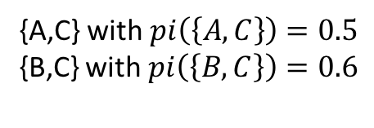
Problem Example
Input:
$$δ=0.5$$
Output:
{A,C} with $pi\left(\left\{A,C\right\}\right)=0.5$
{B,C} with $pi\left(\left\{B,C\right\}\right)=0.6$

Slide 9





Colocation Mining Algorithm: Baseline
Starting with $k=1$
Iterative until no prevalent pattern
Generate size $k$ colocation patterns {$c_{k}\}$
Generate table instance of each $c_{k}$
Compute each ${pi(c}_{k})$, add to result if prevalent
$k=k+1$
k=1
A
B
C
k=2
AB
AC
BC
k=3
ABC
T1 | T2 | T3
A | B | C
A.1 | B.1 | C.1
A.2 | B.2 | C.2
A.3 | B.3 | C.3
A.4 | B.4
 | B.5
T4 | T5 | T6
A B | A C | B C
A.1, B.1 | A.1, C.2 | B.2, C.1
A.2, B.4 | A.3, C.1 | B.4, C.1
A.3, B.4 |  | B.5, C.3
T7
A B C
A.3, B.4, C.1
$pi=0.2$
$pi=0.4$
$pi=0.5$
$pi=0.6$

Slide 10
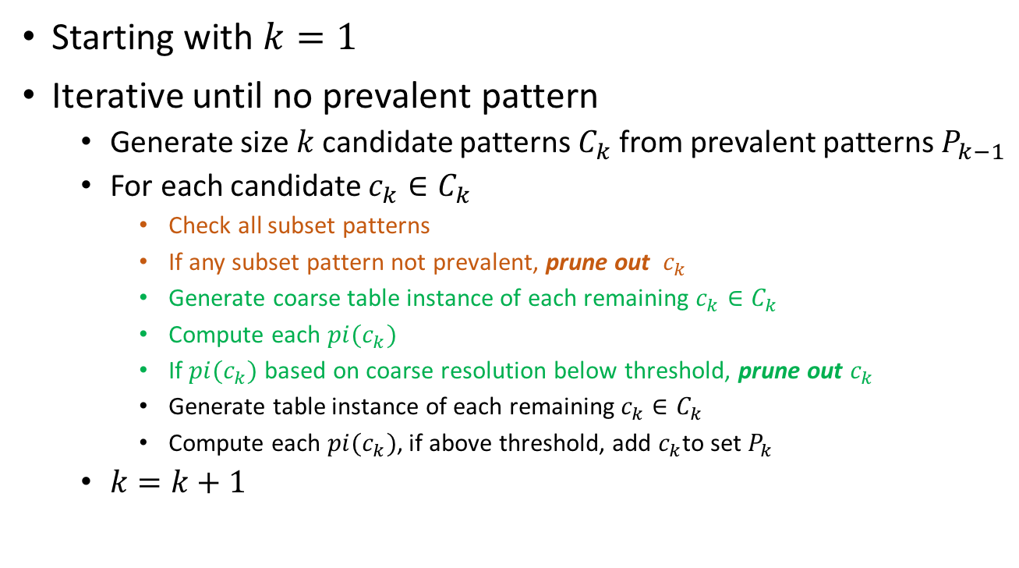
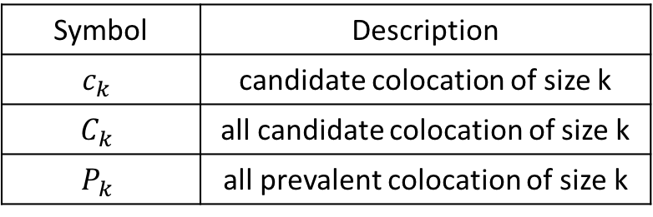
Colocation Mining Algorithm: Filter-Based
Symbol | Description
$$c_{k}$$ | candidate colocation of size k
$$C_{k}$$ | all candidate colocation of size k
$$P_{k}$$ | all prevalent colocation of size k
Starting with $k=1$
Iterative until no prevalent pattern
Generate size $k$ candidate patterns $C_{k}$ from prevalent patterns $P_{k−1}$
For each candidate $c_{k}∈C_{k}$
Check all subset patterns
If any subset pattern not prevalent, prune out $c_{k}$
Generate coarse table instance of each remaining $c_{k}∈C_{k}$
Compute each ${pi(c}_{k})$
If ${pi(c}_{k})$ based on coarse resolution below threshold, prune out $c_{k}$
Generate table instance of each remaining $c_{k}∈C_{k}$
Compute each ${pi(c}_{k})$, if above threshold, add $c_{k}$to set $P_{k}$
$k=k+1$

Slide 11

Prevalence-based Pruning
Lemma (apriori property):
If a colocation pattern $c_{k}$ is not prevalent, then any superset of $c_{k}$ is also not prevalent
Example
T1 | T2 | T3
A | B | C
A.1 | B.1 | C.1
A.2 | B.2 | C.2
A.3 | B.3 | C.3
A.4 | B.4
 | B.5
T4 | T5 | T6
A B | A C | B C
A.1, B.1 | A.1, C.2 | B.2, C.1
A.2, B.4 | A.3, C.1 | B.4, C.1
A.3, B.4 |  | B.5, C.3
k=1
A
B
C
k=2
AB
AC
BC
$pi=0.4$
$pi=0.5$
$pi=0.6$
Don’t need to check (A,B,C)

Slide 12
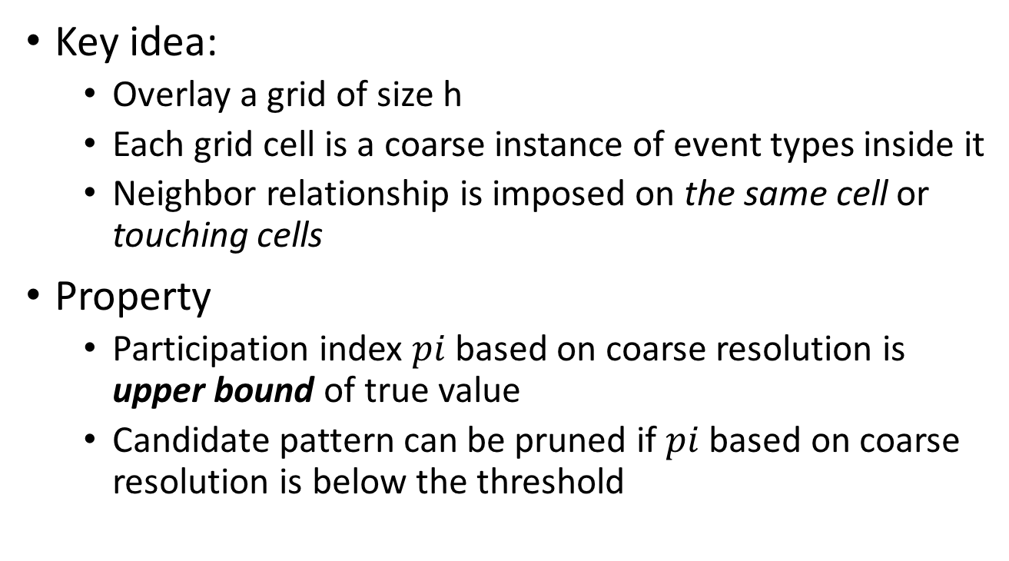
Multi-resolution Pruning
Key idea:
Overlay a grid of size h
Each grid cell is a coarse instance of event types inside it
Neighbor relationship is imposed on the same cell or touching cells
Property
Participation index $pi$based on coarse resolution is upper bound of true value
Candidate pattern can be pruned if $pi$ based on coarse resolution is below the threshold

Slide 13
Reference
[1] Huang, Yan, Shashi Shekhar, and Hui Xiong. "Discovering colocation patterns from spatial data sets: a general approach." IEEE Transactions on Knowledge and data engineering 16.12 (2004): 1472-1485.

